Slide 1
Unbiasing Fermionic Quantum Monte Carlo with a Quantum Computer
Carter M. Gustin
Tufts University

Slide 2



Quantum Monte Carlo
QMC algorithms target the ground state of a system, via imaginary time ($τ=it$) evolution of an initial state
Notes:
QMC is a class of algorithms

Slide 3

Quantum Monte Carlo
QMC algorithms target the ground state of a system, via imaginary time ($τ=it$) evolution of an initial state

Slide 4

Quantum Monte Carlo
QMC algorithms target the ground state of a system, via imaginary time ($τ=it$) evolution of an initial state

Slide 5
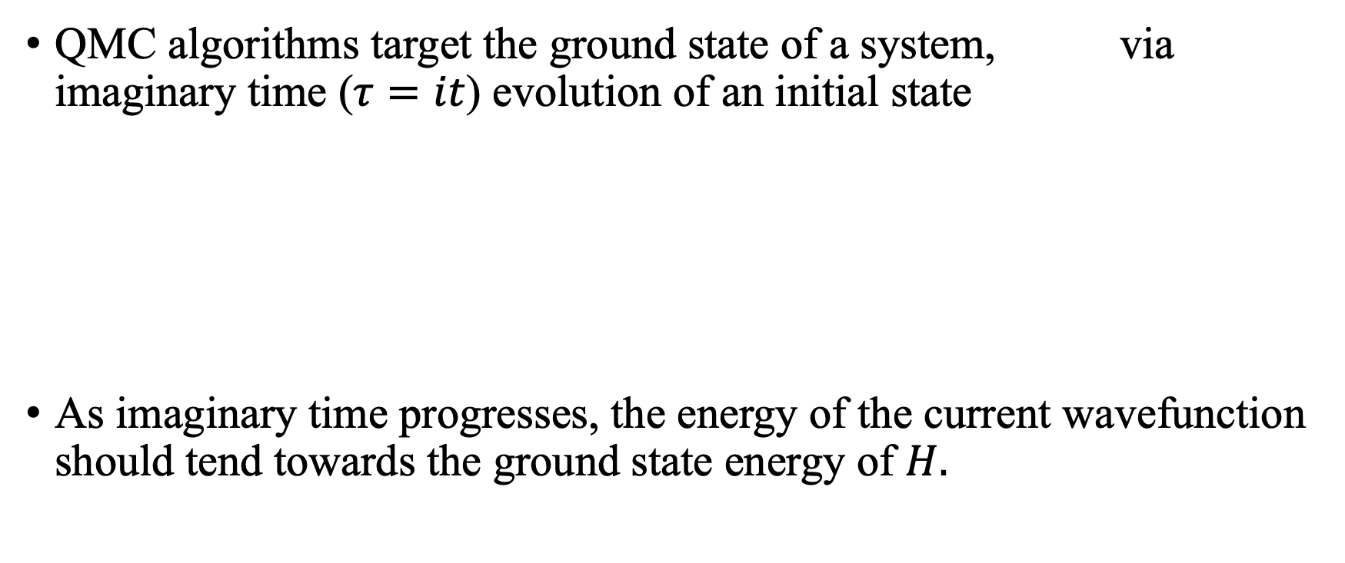
Quantum Monte Carlo
QMC algorithms target the ground state of a system, via imaginary time ($τ=it$) evolution of an initial state
As imaginary time progresses, the energy of the current wavefunction should tend towards the ground state energy of $H.$

Slide 6
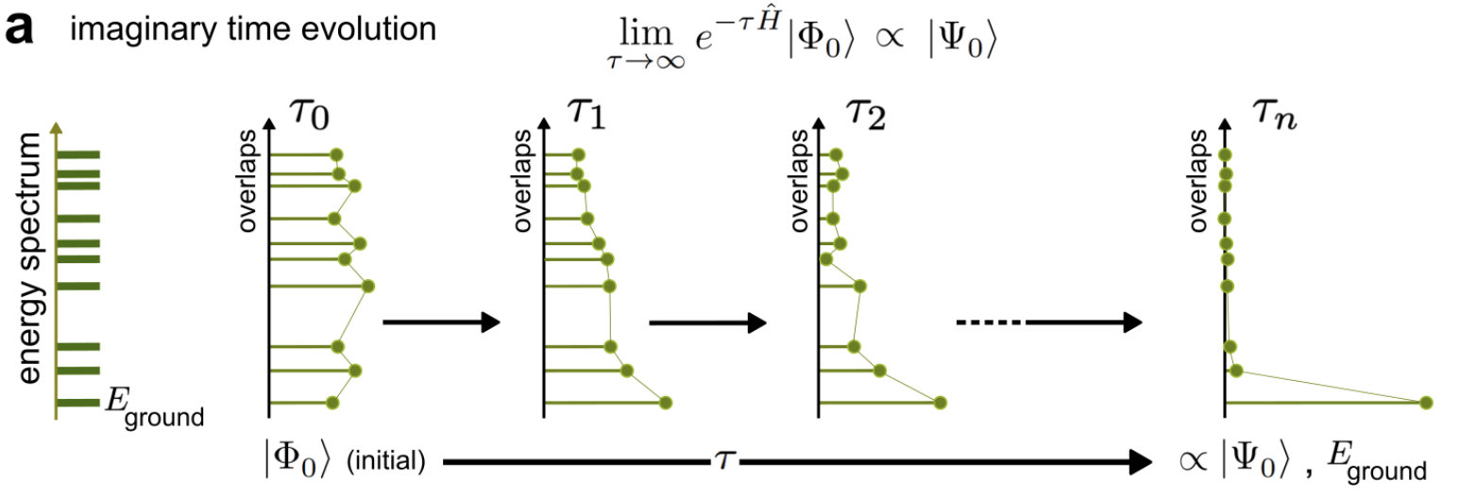
Imaginary Time Evolution
Notes:
Each energy on the energy spectrum corresponds to some \psi. As t->inf, only the ground state \psi has nonzero overlap

Slide 7
Auxiliary Field QMC
AFQMC is a projector QMC algorithm used to find the ground state of a system.

Slide 8

Auxiliary Field QMC
AFQMC is a projector QMC algorithm used to find the ground state of a system.
The wavefunction is given by:
Notes:
Phi_i (t) is the ith walker at time tau
Psi_T is the trial wavefunction that “guides” the walkers

Slide 9
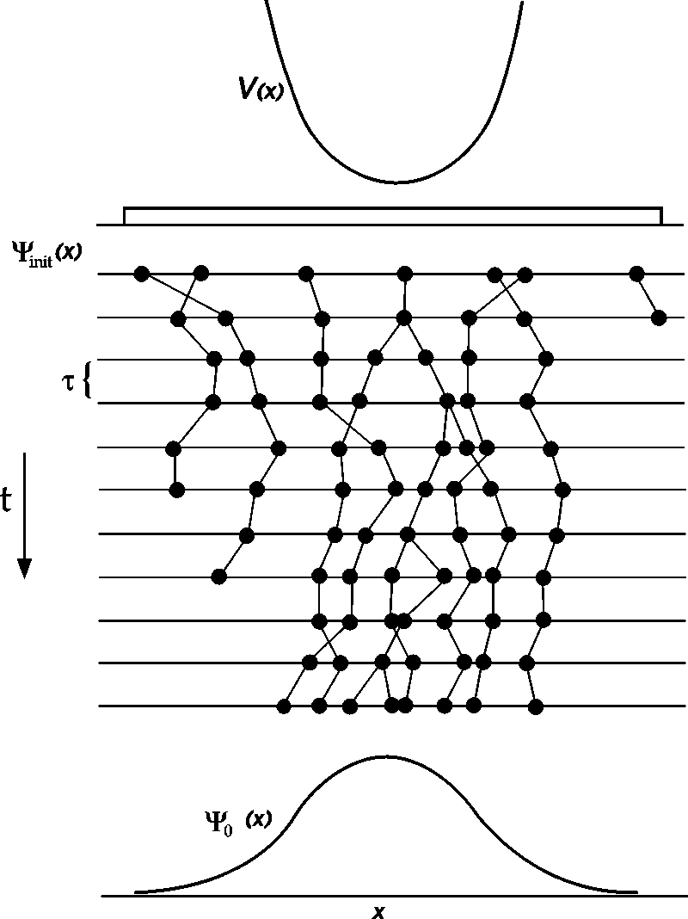
Auxiliary Field QMC
AFQMC is a projector QMC algorithm used to find the ground state of a system.
The wavefunction is given by:
https://www.researchgate.net/figure/Illustration-of-the-walker-evolution-in-the-diffusion-Monte-Carlo-DMC-method-The_fig1_2464596

Slide 10
Fermionic Sign Problem
In the Metropolis Algorithm (which QMC is based on), the probability that the system goes from one state to another is given by the Boltzmann distribution and partition function

Slide 11
Fermionic Sign Problem
In the Metropolis Algorithm (which QMC is based on), the probability that the system goes from one state to another is given by the Boltzmann distribution and partition function
We must map the quantum partition function to the classic analogue:

Slide 12
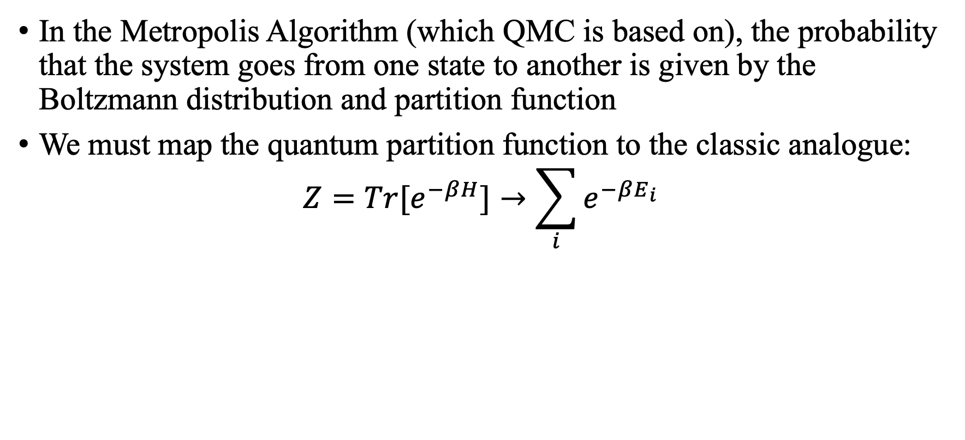
Fermionic Sign Problem
In the Metropolis Algorithm (which QMC is based on), the probability that the system goes from one state to another is given by the Boltzmann distribution and partition function
We must map the quantum partition function to the classic analogue:
$$Z=Tr[e^{−βH}]→\sum_{i}{e^{−βE_{i}}}$$

Slide 13
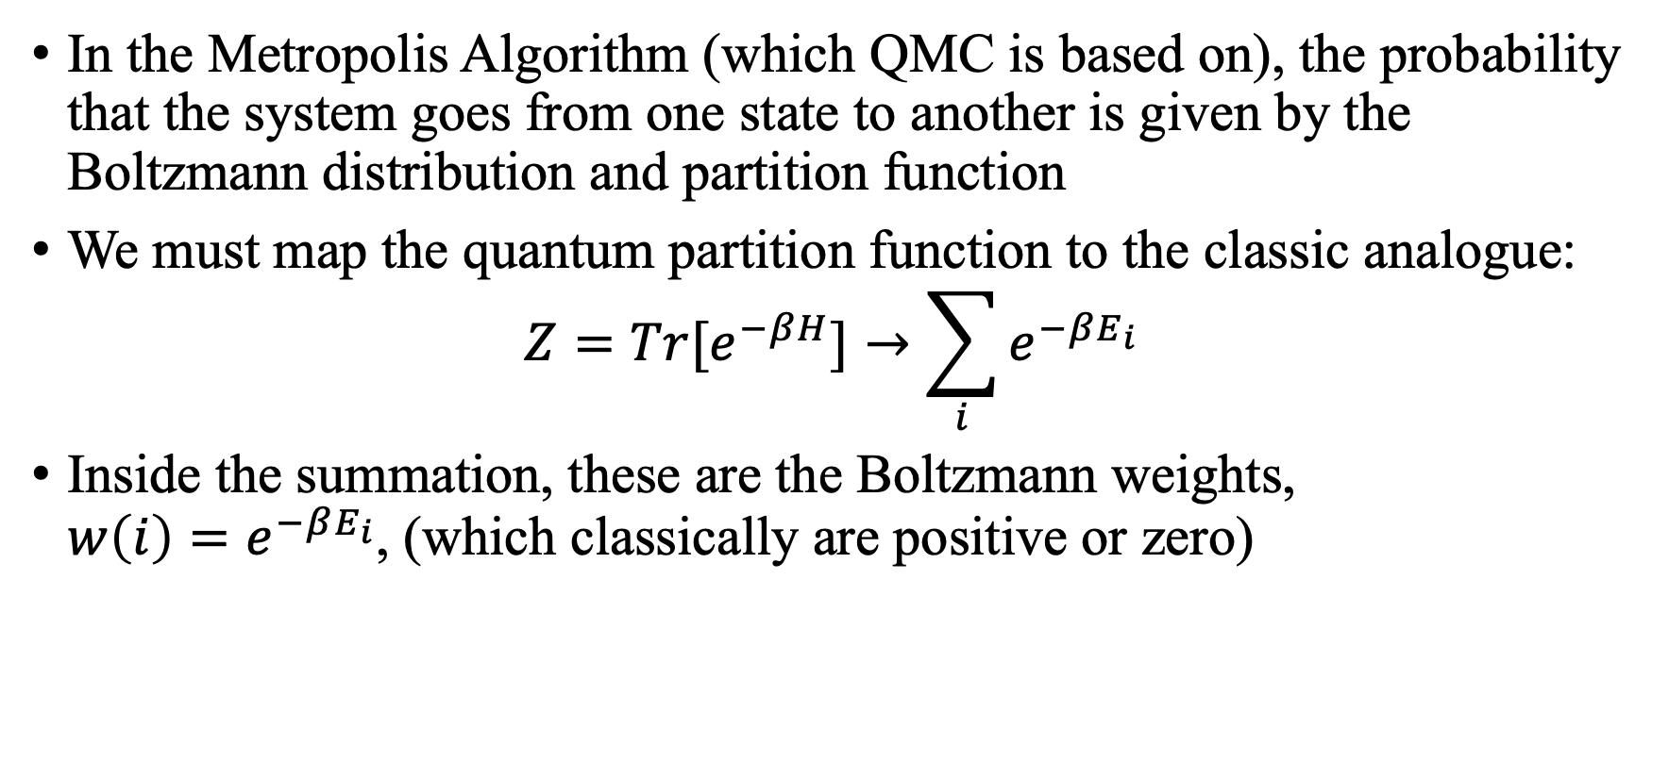
Fermionic Sign Problem
In the Metropolis Algorithm (which QMC is based on), the probability that the system goes from one state to another is given by the Boltzmann distribution and partition function
We must map the quantum partition function to the classic analogue:
$$Z=Tr[e^{−βH}]→\sum_{i}{e^{−βE_{i}}}$$
Inside the summation, these are the Boltzmann weights, $w\left(i\right)=e^{−βE_{i}}$, (which classically are positive or zero)

Slide 14
Fermionic Sign Problem
Due to the antisymmetry of Fermionic wavefunctions, these Boltzmann weights can be negative (due to Pauli exclusion principle)

Slide 15
Fermionic Sign Problem
Due to the antisymmetry of Fermionic wavefunctions, these Boltzmann weights can be negative (due to Pauli exclusion principle)
Combinations of positive and negative Boltzmann weights yield exponential growth in the statistical errors (proof is omitted for brevity)

Slide 16
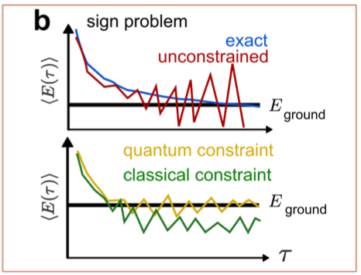
Fermionic Sign Problem

Slide 17
How to Handle the Sign Problem
In order to obtain the ground state energy with polynomially bounded variance, constraints must be imposed

Slide 18

How to Handle the Sign Problem
In order to obtain the ground state energy with polynomially bounded variance, constraints must be imposed
Sign problem → Constraints → Biases in $E_{0}$

Slide 19
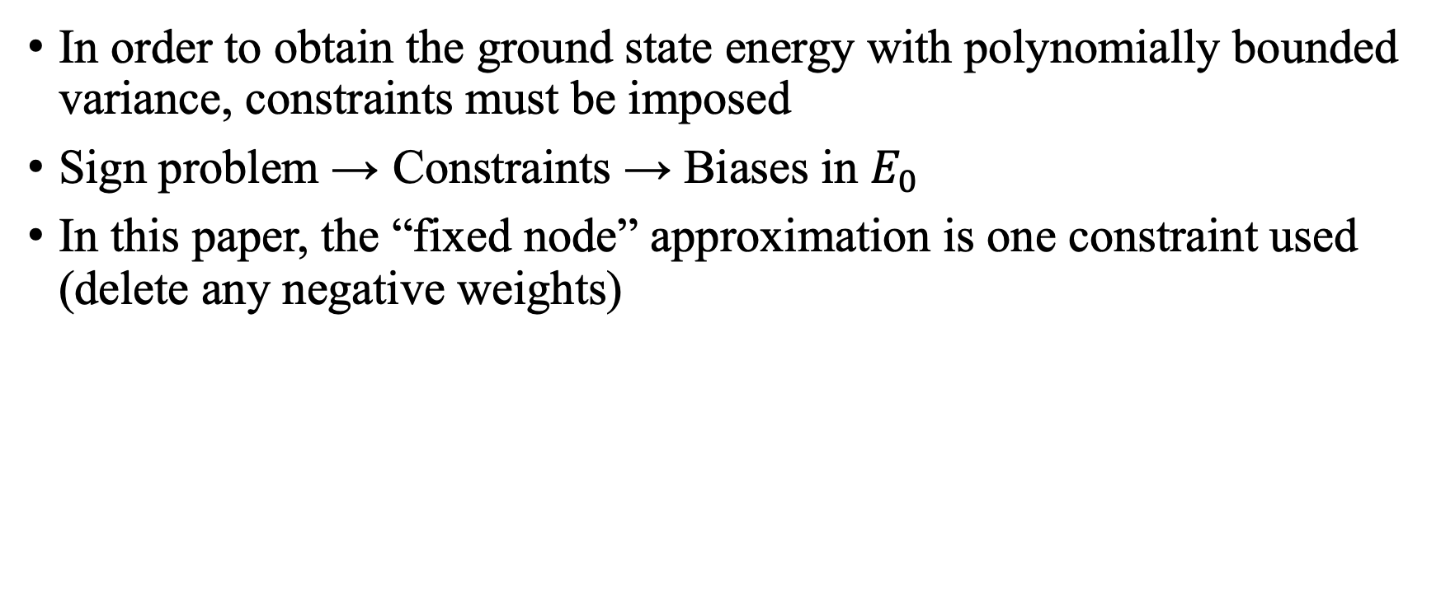
How to Handle the Sign Problem
In order to obtain the ground state energy with polynomially bounded variance, constraints must be imposed
Sign problem → Constraints → Biases in $E_{0}$
In this paper, the “fixed node” approximation is one constraint used (delete any negative weights)

Slide 20
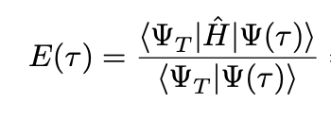

Quantum-Classical Hybrid AFQMC Algorithm (QC-AFQMC)
The energy in AFQMC is given by:
We need to calculate for each walker and every timestep
Notes:
QC-AFQMC works to remove bias
Phi(tau) is built up of phi

Slide 21
Quantum-Classical Hybrid AFQMC Algorithm (QC-AFQMC)
The energy in AFQMC is given by:
We need to calculate for each walker and every timestep
This is inefficient on a classical computer, but efficient on a quantum computer
How can we utilize both the classical and quantum processors to maximize the efficiency?
Notes:
Phi(tau) is built up of phi

Slide 22
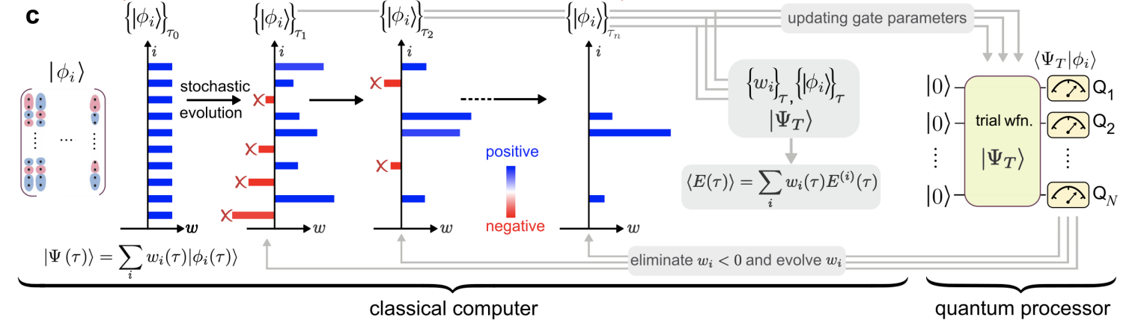
QC-AFQMC Overview
Notes:
Energy calculation done on classical processor while w_i’s are updated on quantum processor

Slide 23
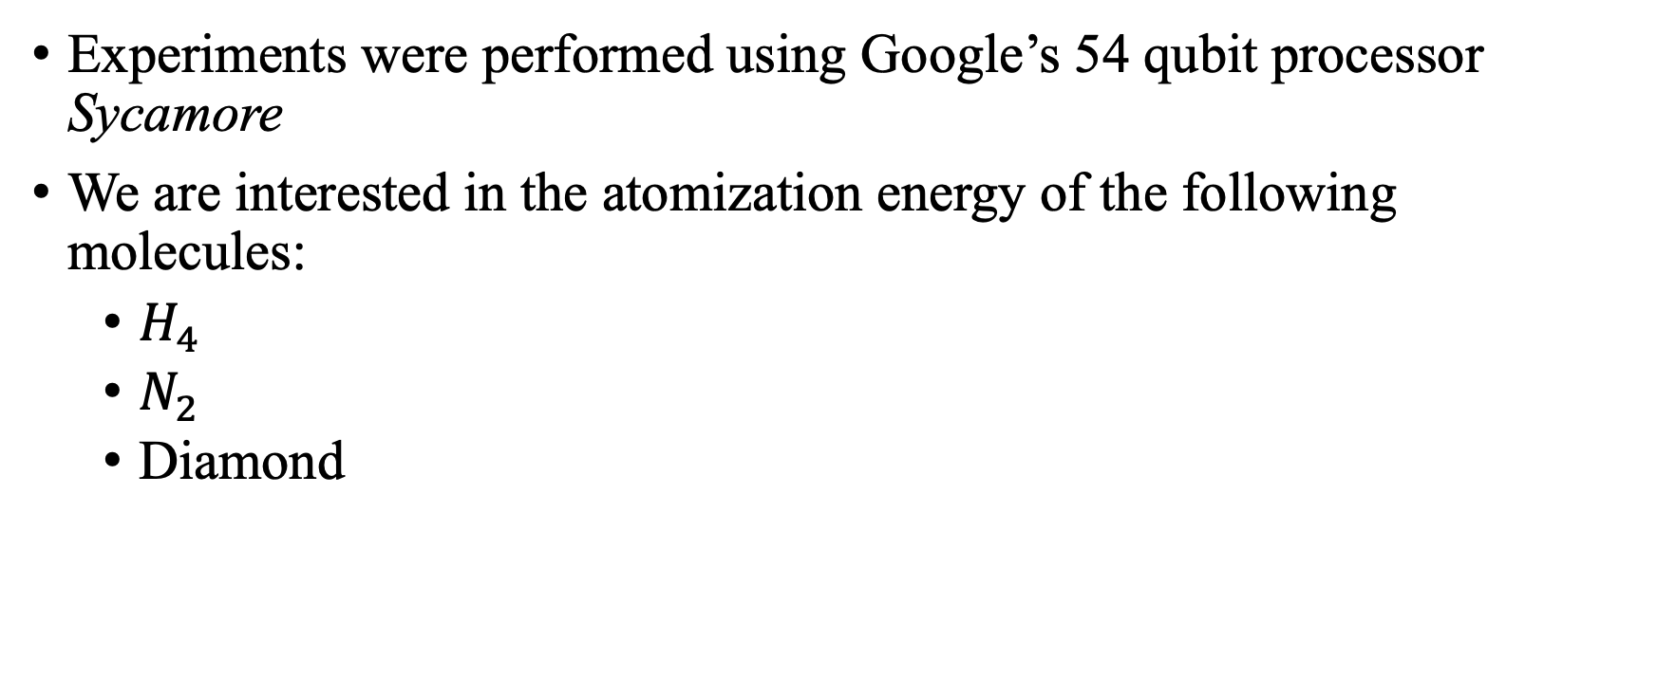
Results
Experiments were performed using Google’s 54 qubit processor Sycamore
We are interested in the atomization energy of the following molecules:
$H_{4}$
$N_{2}$
Diamond

Slide 24


$$H_{4}$$
We start with a square geometry
 | Exact | AFQMC | QC-AFQMC
4 Orbital | 64.7 | 62.9 | 64.3
120 Orbital | 70.5 | 68.6 | 69.7
Atomization Energy of $H_{4}$ (kcal/mol)

Slide 25
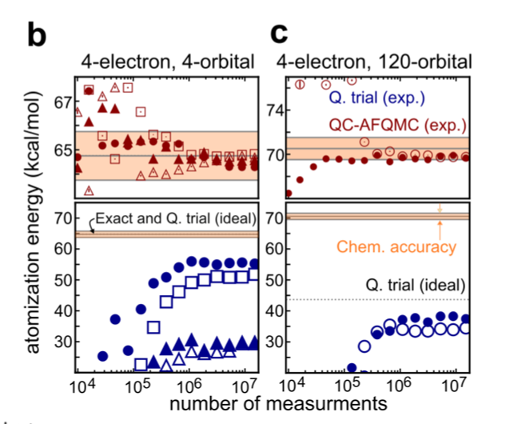
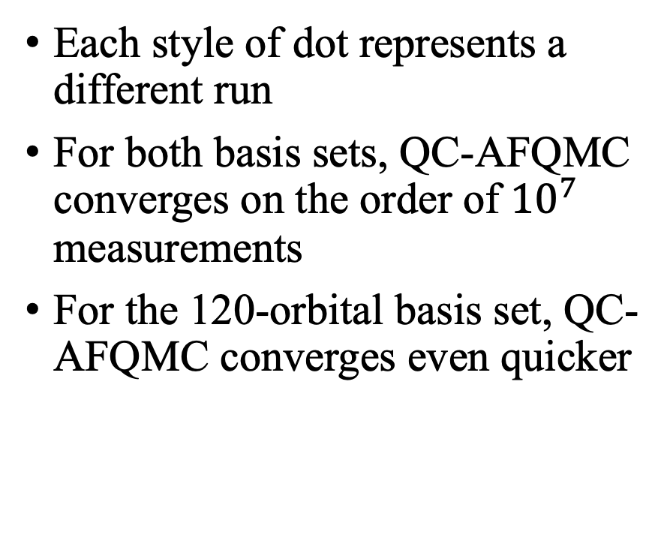
$$H_{4}$$
Each style of dot represents a different run
For both basis sets, QC-AFQMC converges on the order of ${10}^{7}$ measurements
For the 120-orbital basis set, QC-AFQMC converges even quicker

Slide 26
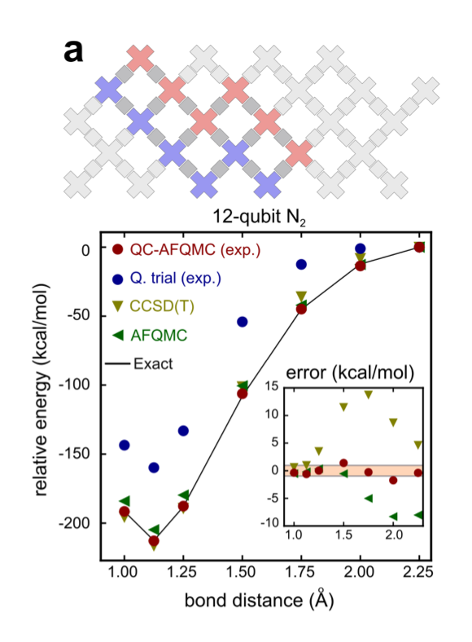


$$N_{2}$$
In this experience, 12 qubits are used
We use a linear geometry:
Again, QC-AFQMC gives closest results (however, not within chem. Accuracy 1kcal/mol)
Takeaway: Even with a simple trial wavefunction, our energies are close to those from state-of-the-art tech.

Slide 27
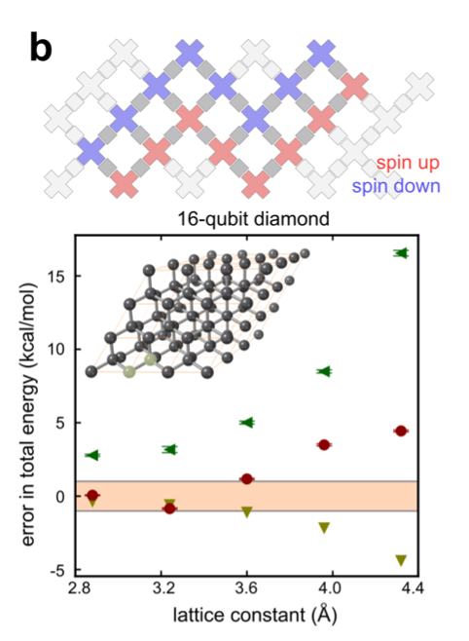
Diamond
In this experiment, the lattice constant of diamond is being discovered with 16 qubits
At this size, the model exhibits significant finite-size effects
Correct experimental lattice constant not predicted
This is the largest-to-date simulation quantum computer (as of July 2021)
QC-AFQMC is as accurate as state-of-the-art method for a range of lattice constants

Slide 28
Source
“Unbiasing Fermionic Monte Carlo with a Quantum Computer”
https://arxiv.org/pdf/2106.16235.pdf

